Slide 1

JMP Intro Tutorial For Engineers and Scientists
J.D. Landgrebe,
Dept. of Chemical Engineering
landgreb@udel.edu

Slide 2

Getting Started With JMP® Software
JMP is ideal for reshaping, exploring and analyzing ad hoc data as an engineer
https://www.jmp.com/en_us/home.html
https://www.sas.com/en_us/software/viya.html
Widely used in various industries -- Pharma, Semiconductors, Consumer Goods etc.
Recommended over Excel® and Python for exploratory analysis and visualization
Ease-of-use suited for fast-paced and thorough analysis
Designed with thoughtful combo of statistics and visuals describing data
JMP guides to good statistical practices for non-statisticians

Slide 3
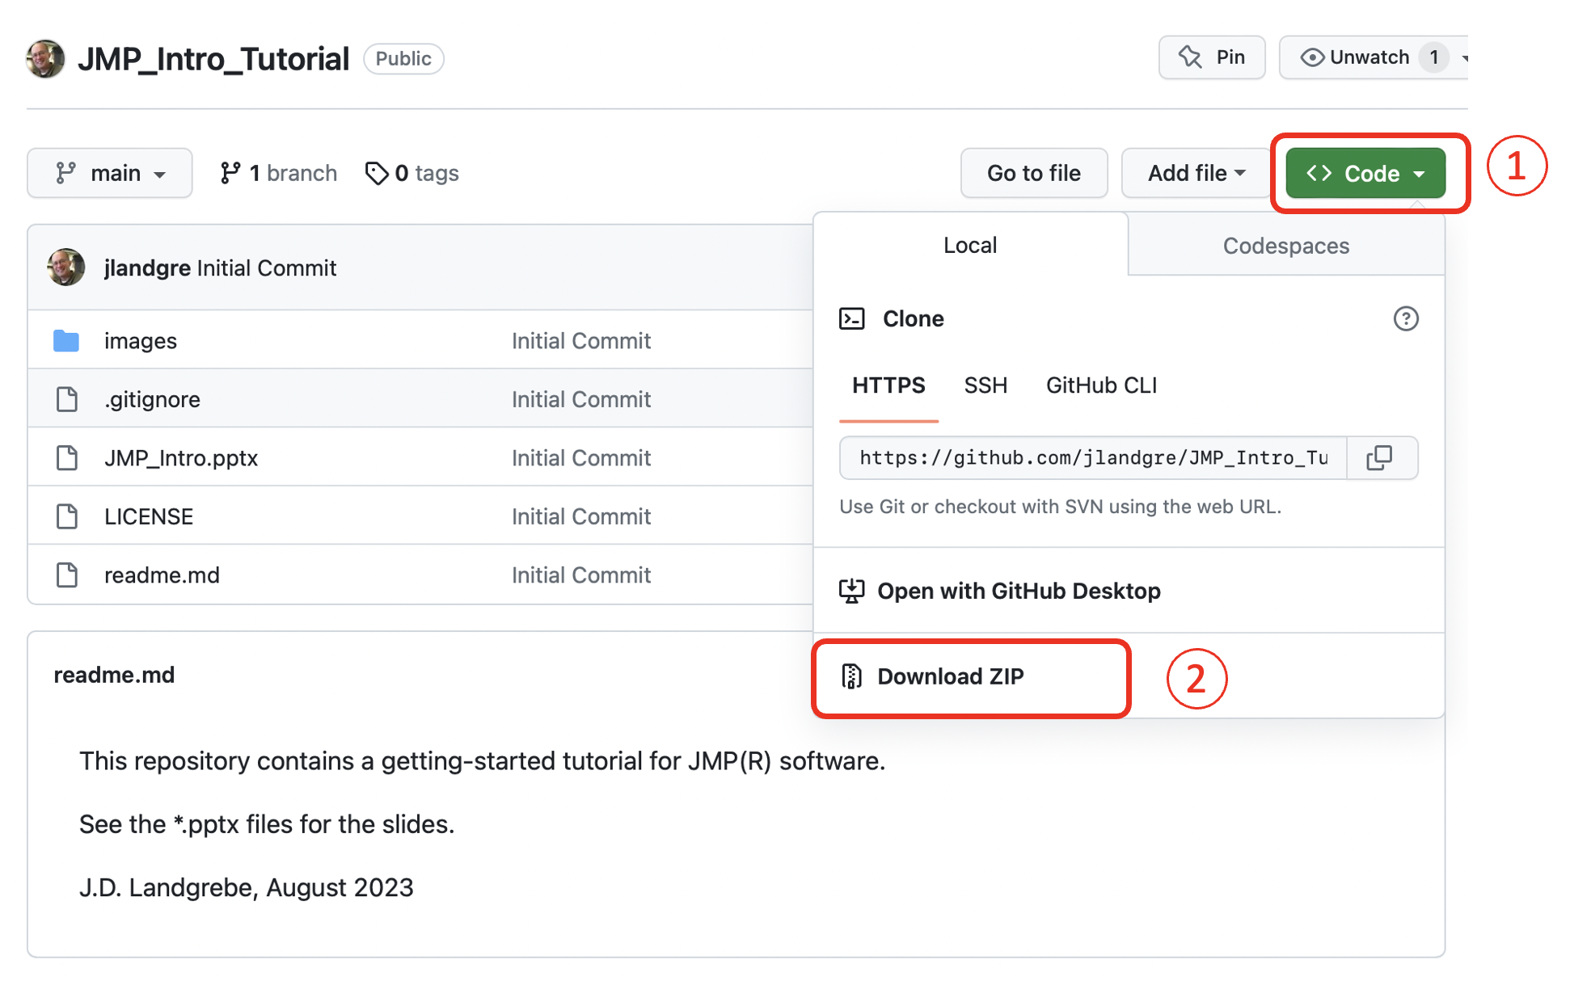
Downloading Tutorial Files
Download tutorial materials from Github repository: https://github.com/jlandgre/JMP_Intro_Tutorial
Github: Good for engineers to know! It’s common for sharing open-source materials like this tutorial
Github repositories can be open (like this one) or private

Slide 4
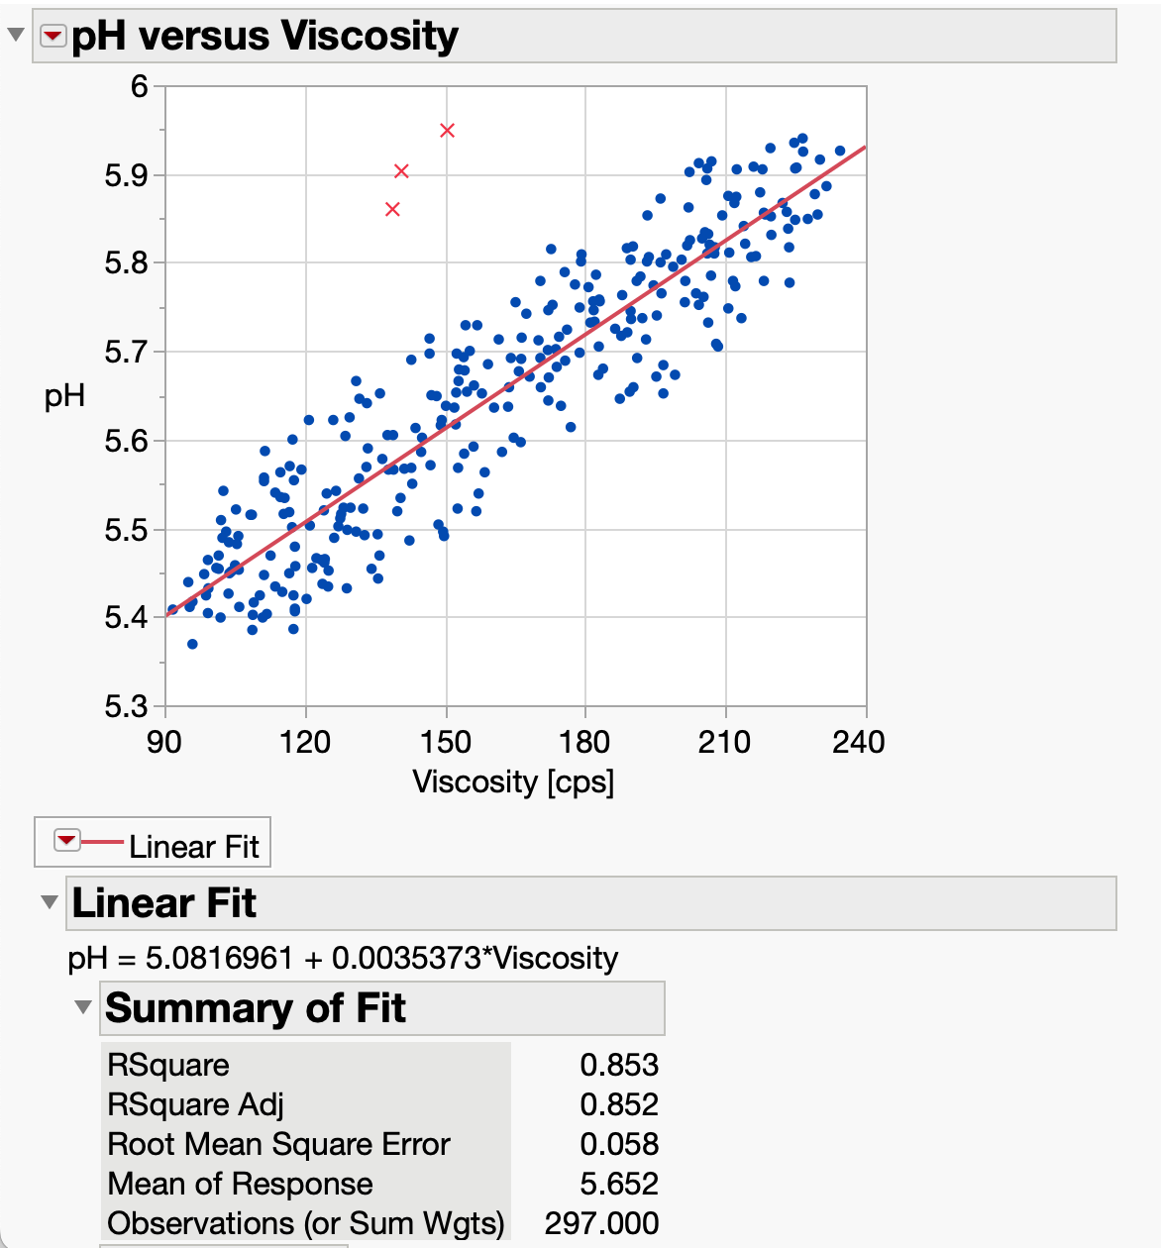
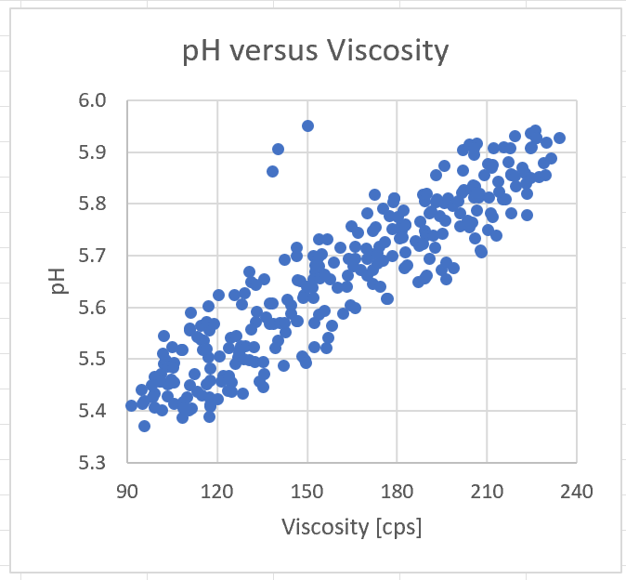
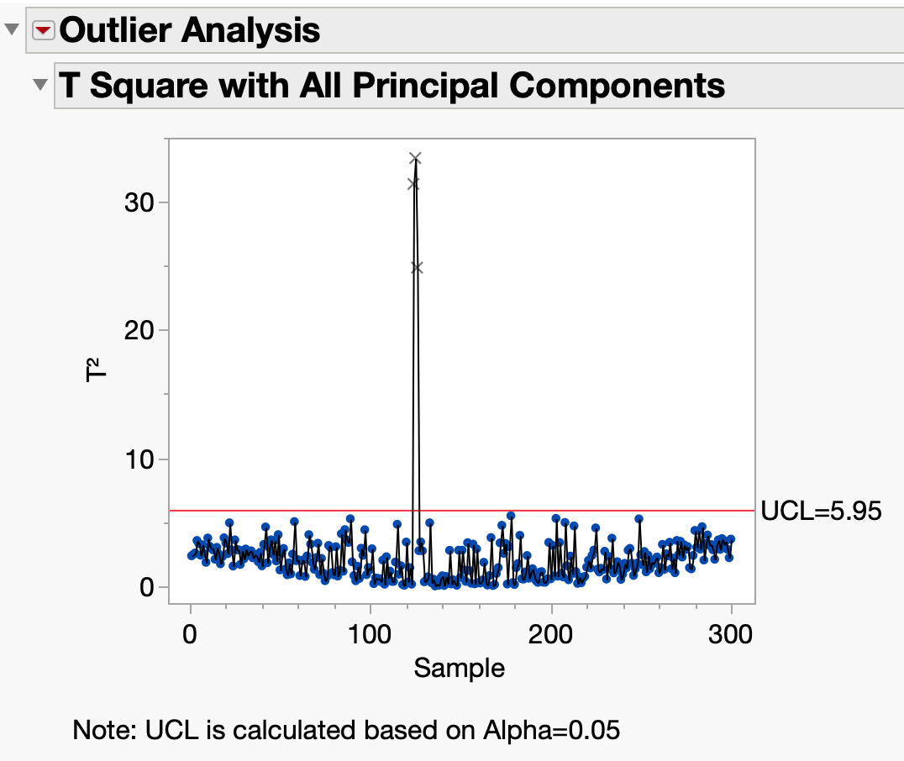
Why JMP?
Linear fit with outliers excluded
Easy-to-use data reshaping tools
Combine stats and visuals
Guidance on use of stats
Ability to explore subsets of data
Training resources (jmp.com/learn)
MS Excel or Python Plots:
No stats built in
Hard to explore fit omitting outliers
Stats expertise needed to perform outlier analysis in Python/SciKit Learn
Are outliers abnormal combo of pH and viscosity? [Yes! T² outliers Significant with p<0.05 ]

Slide 5
JMP Getting Started Topics
This customized tutorial covers:
Why JMP?
Installation and accessing tutorials that come with the install
Opening files and performing basic analyses
Data selection, Column info and Data Types
Accessing JMP tutorials for additional topics

Slide 6
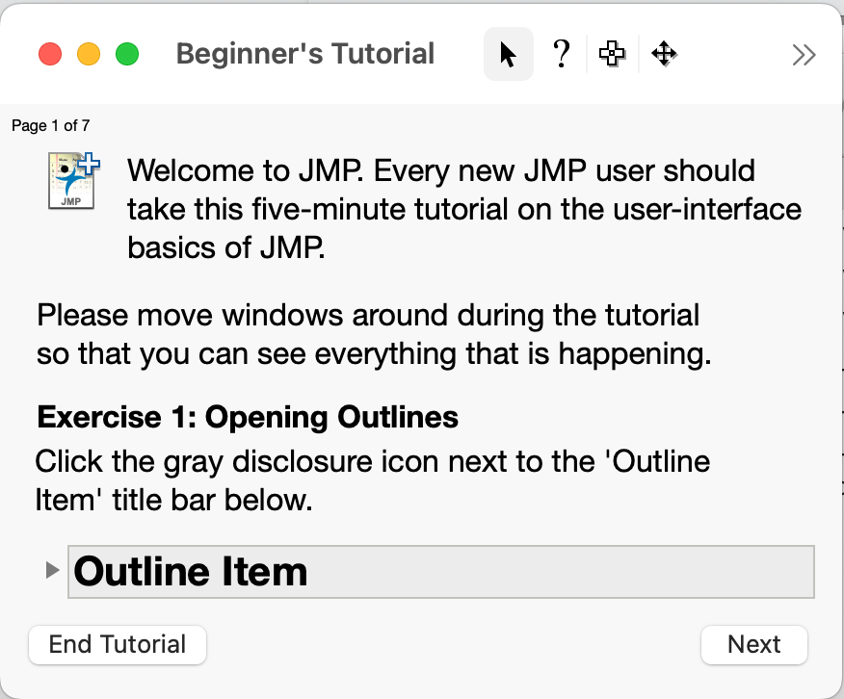
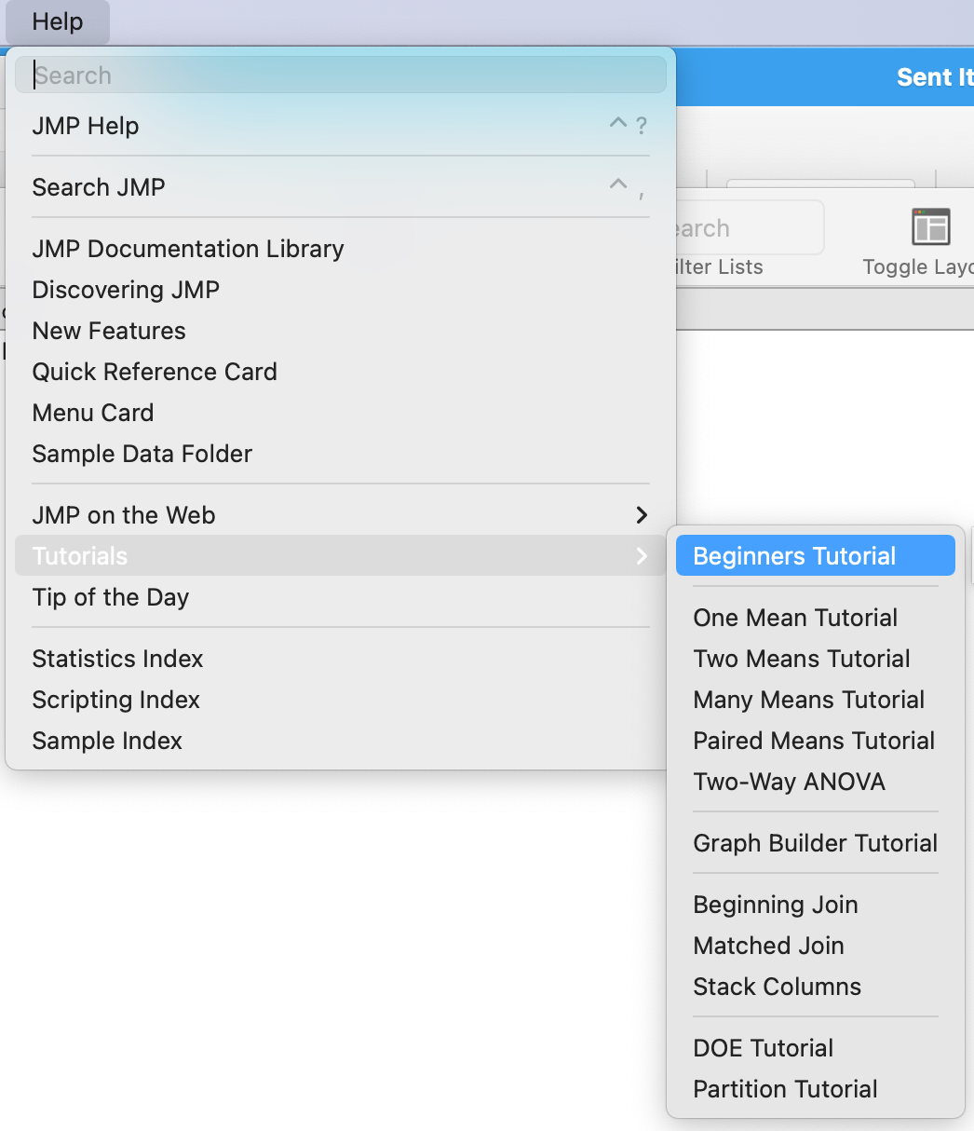
accessing Built-In tutorials
Installation also installs references and resources for learning
As an exercise, launch JMP, choose the Help menu and browse what’s there
Take the 5-minute Beginners Tutorial to get a feel for how JMP works

Slide 7
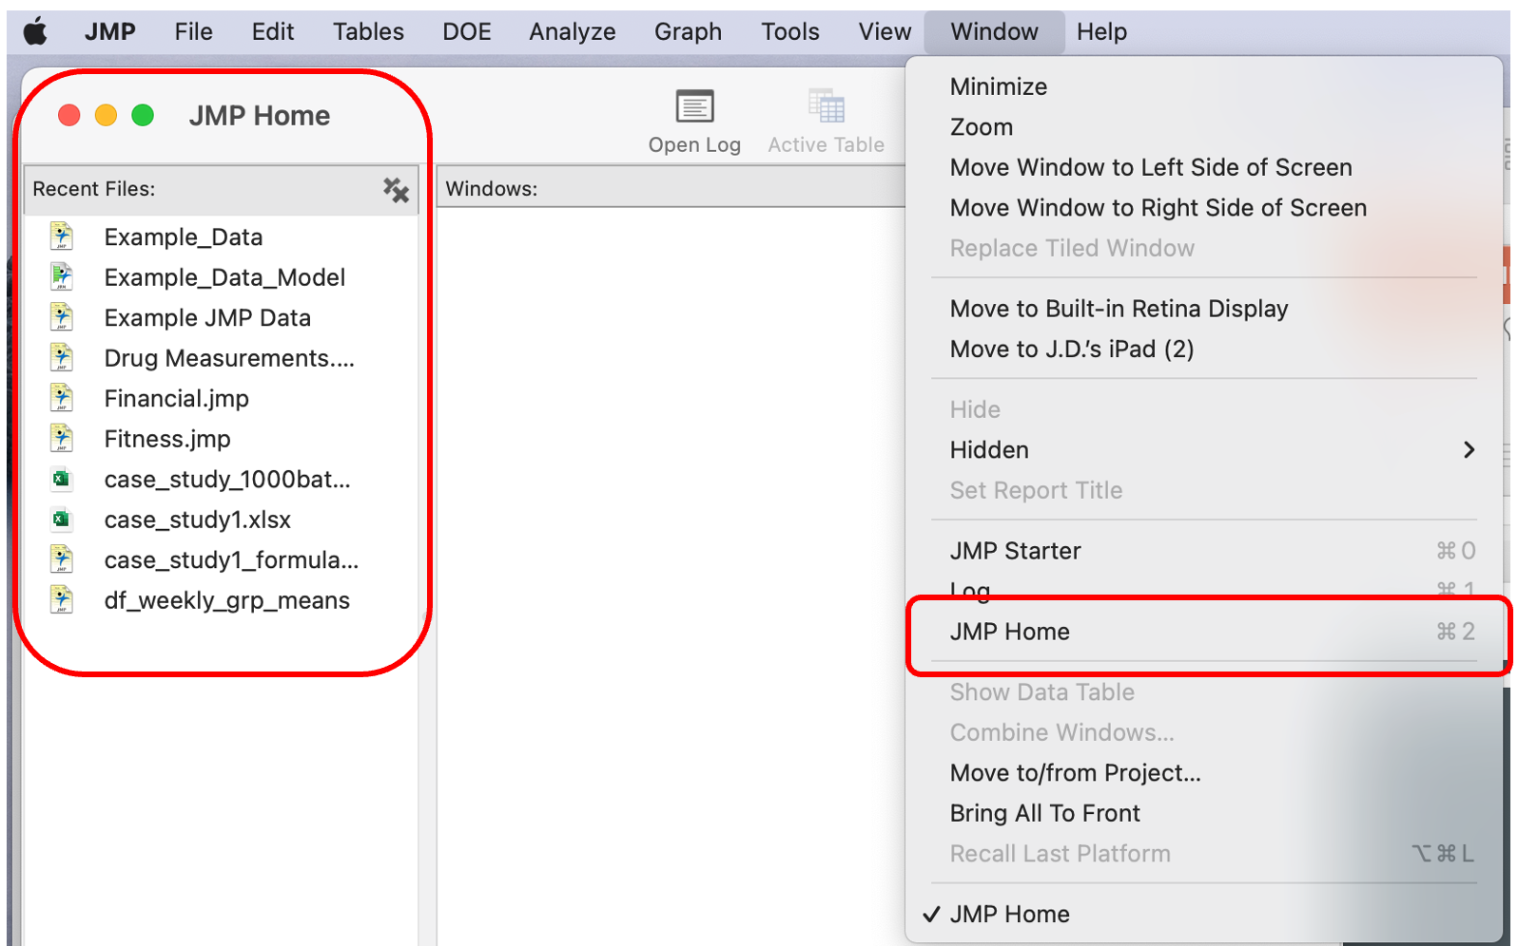
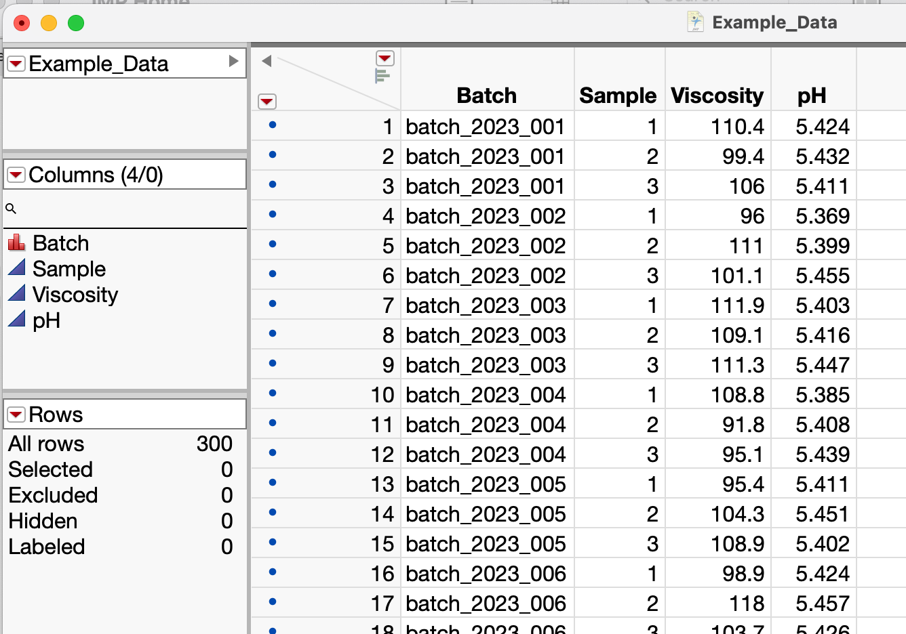
Opening Data Files
JMP can open various formats (*.xlsx, *.csv, Google Sheets etc.)
JMP Home (Window / JMP Home) shows recent files
Exercise: Open the Example_Data.jmp file

Slide 8
Opening Files and Conducting Basic Analyses
Opening files
Performing basic analyses with Example_Data.jmp
Distributions of data
Fit Y by X to look at combination of variables
Summarizing data

Slide 9
Data Table Window
Click here to clear row and column selections
Variable names
Panes contain data table info
Unlike spreadsheet, variable name is not “first row”
Row state summary is helpful especially with large data tables
Nominal (categorical) variable
Continuous (numerical) variables
Row state summary

Slide 10
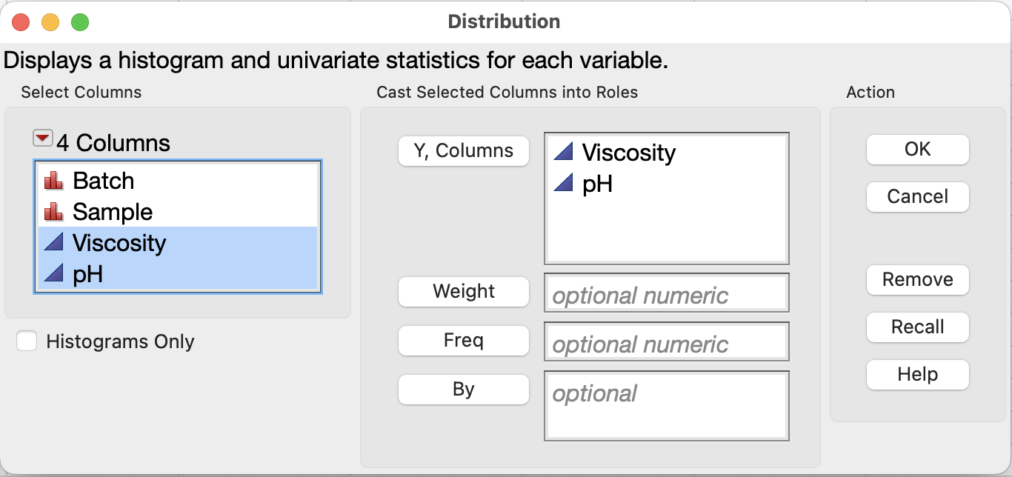
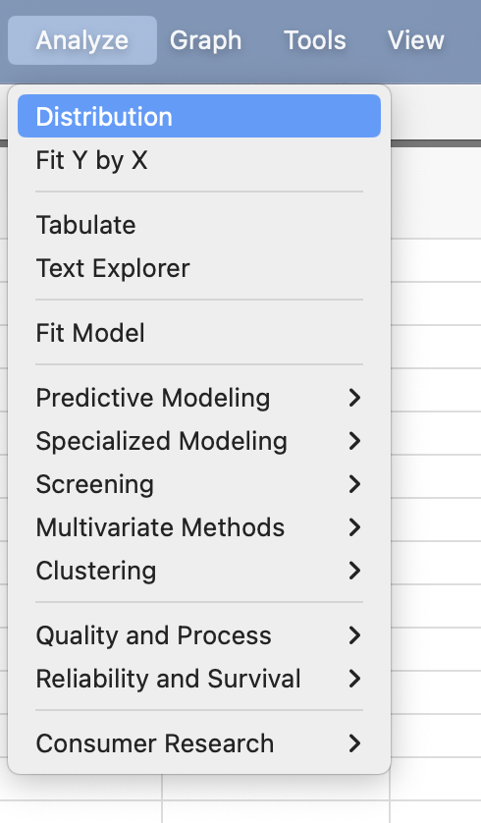
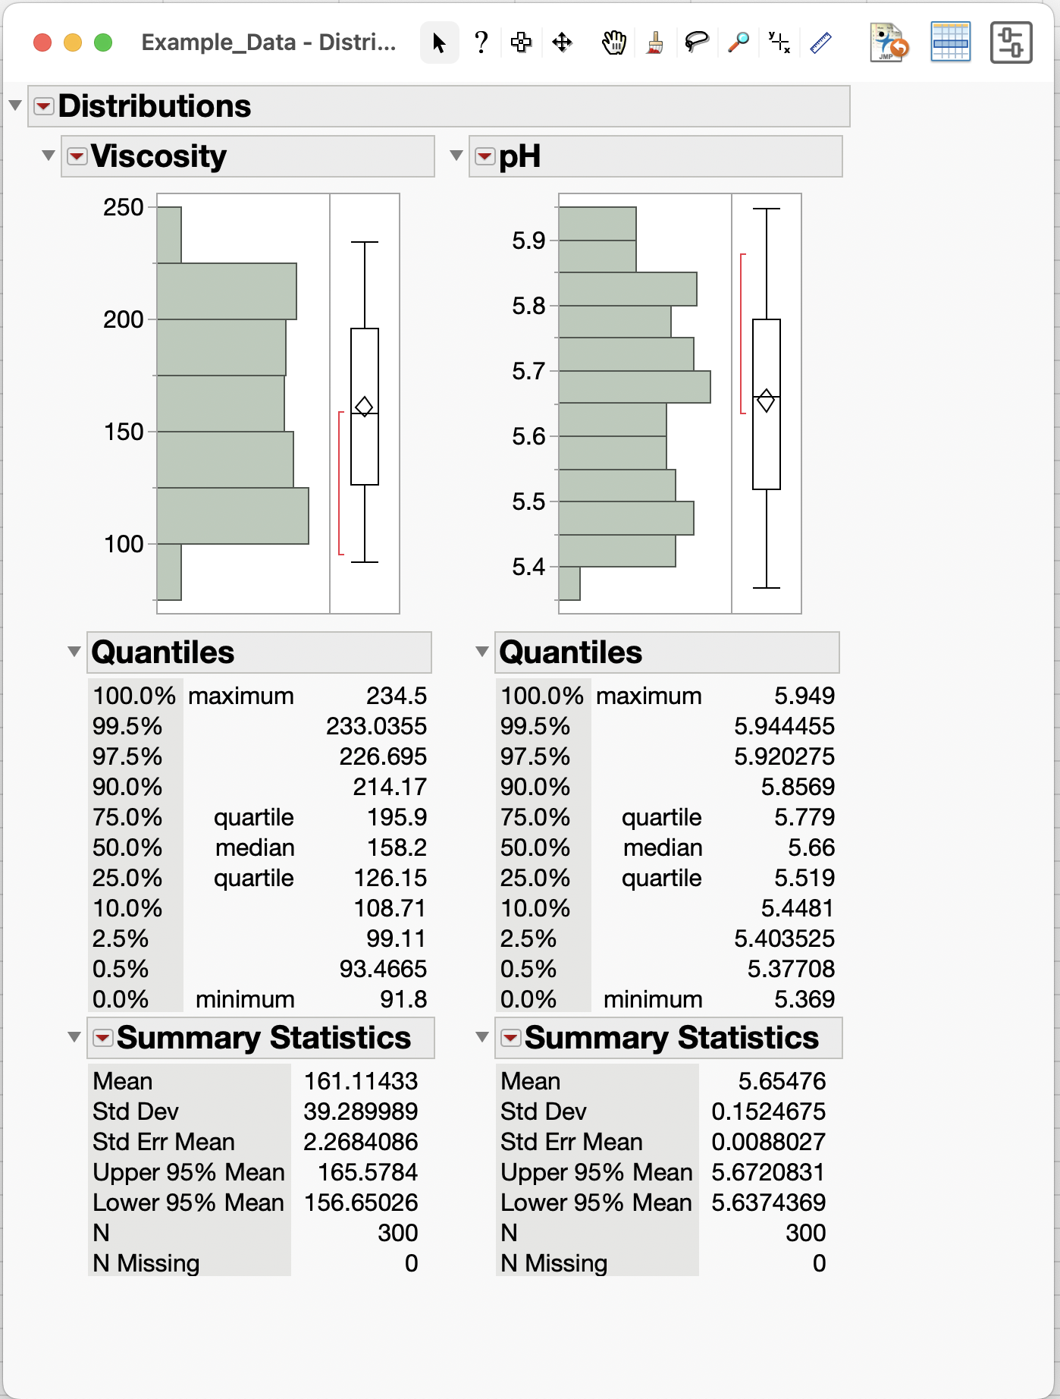
Basic Analyses (Distribution of Data)
1
2
Analyze menu has available analyses
Choose Analyze / Distribution to view distributions and stats for Viscosity and pH data
Drag variables to Y, Columns box and click OK button

Slide 11
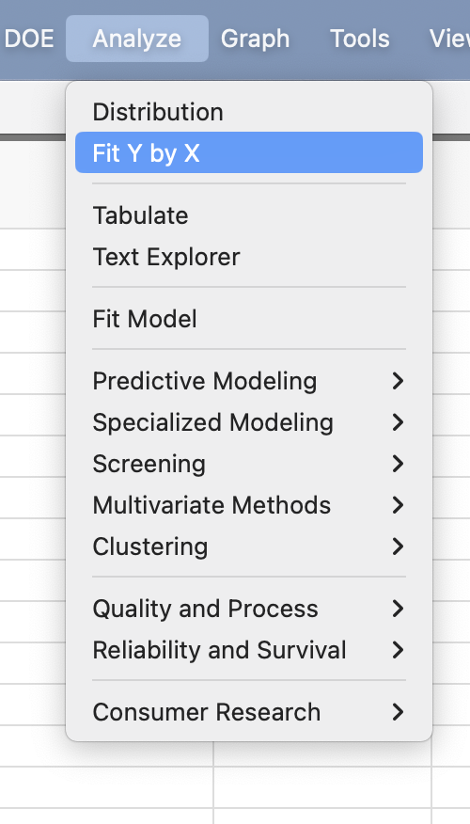
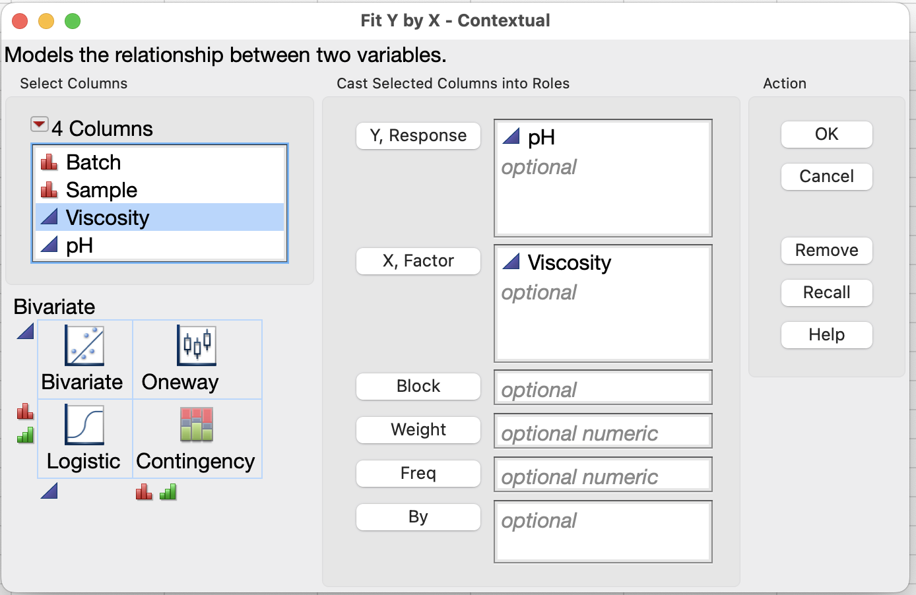
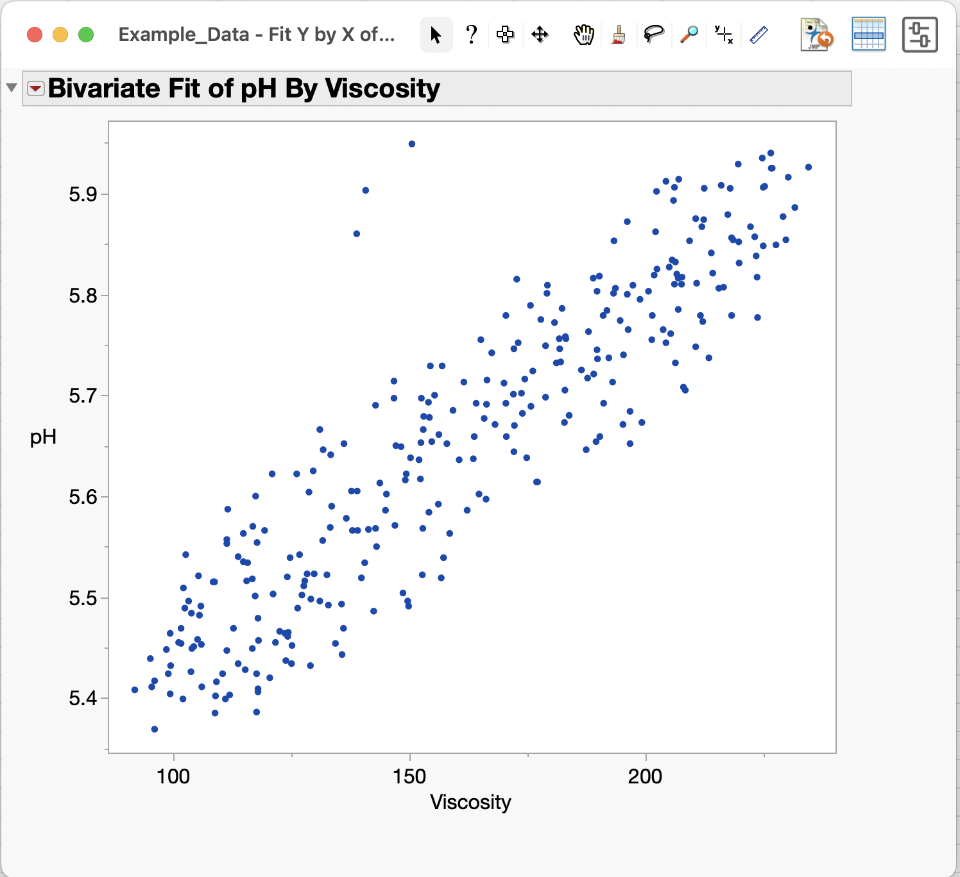
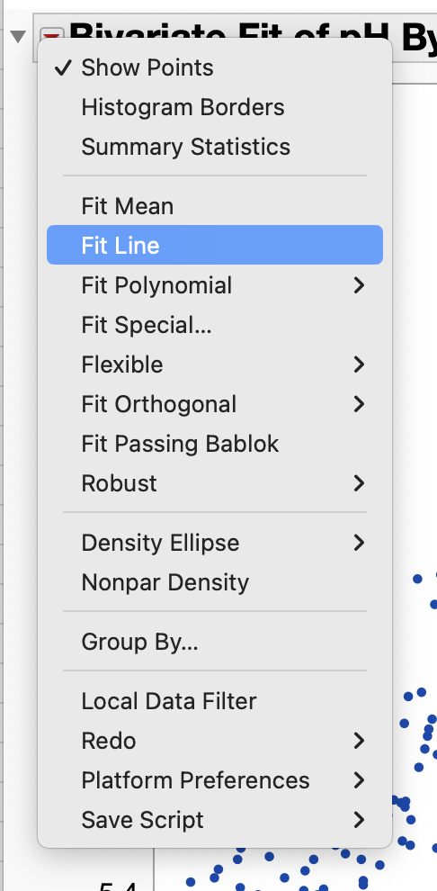
Basic Analyses (Fit Y by X)
2
1
Analyze menu has available analyses
Choose Analyze / Fit Y by X to create a scatterplot with Viscosity and pH data
Red arrow menu has analysis and fitting options
3

Slide 12
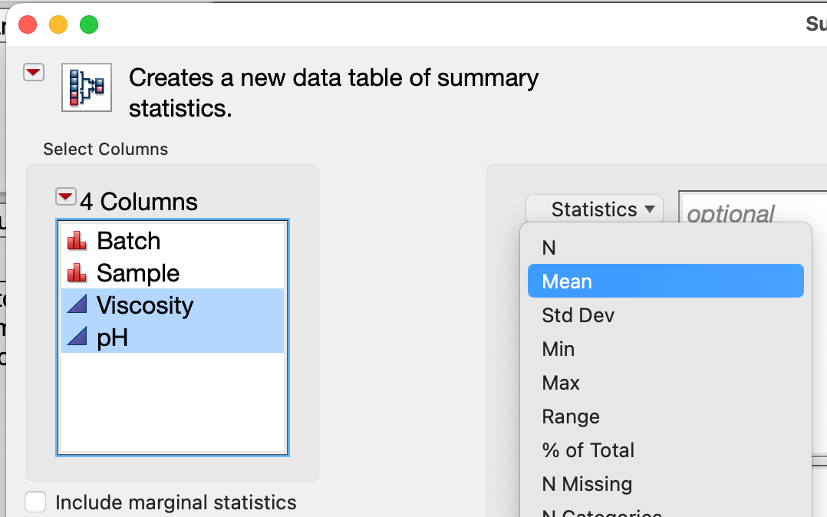
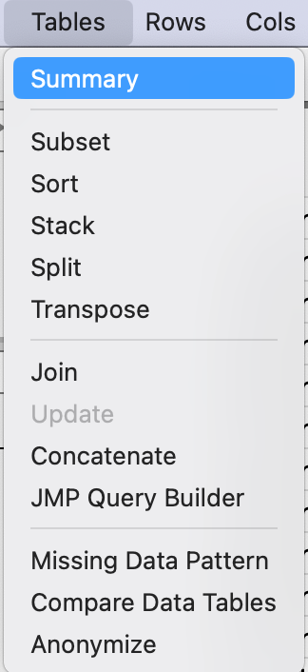
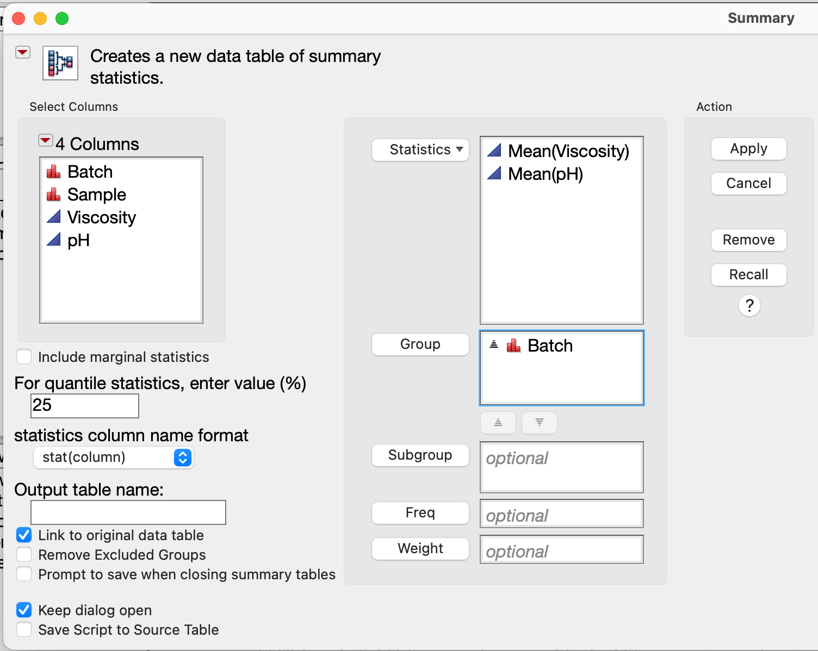
Basic Analyses (Summarize By)
2
1
Tables menu has available summary and data reshaping actions
Choose Tables / Summary to get averages by Batch
Helpful options for customizing
statistics column name format
Keep dialog open
Use “Apply” button once satisfied with Summary preview
4
3

Slide 13
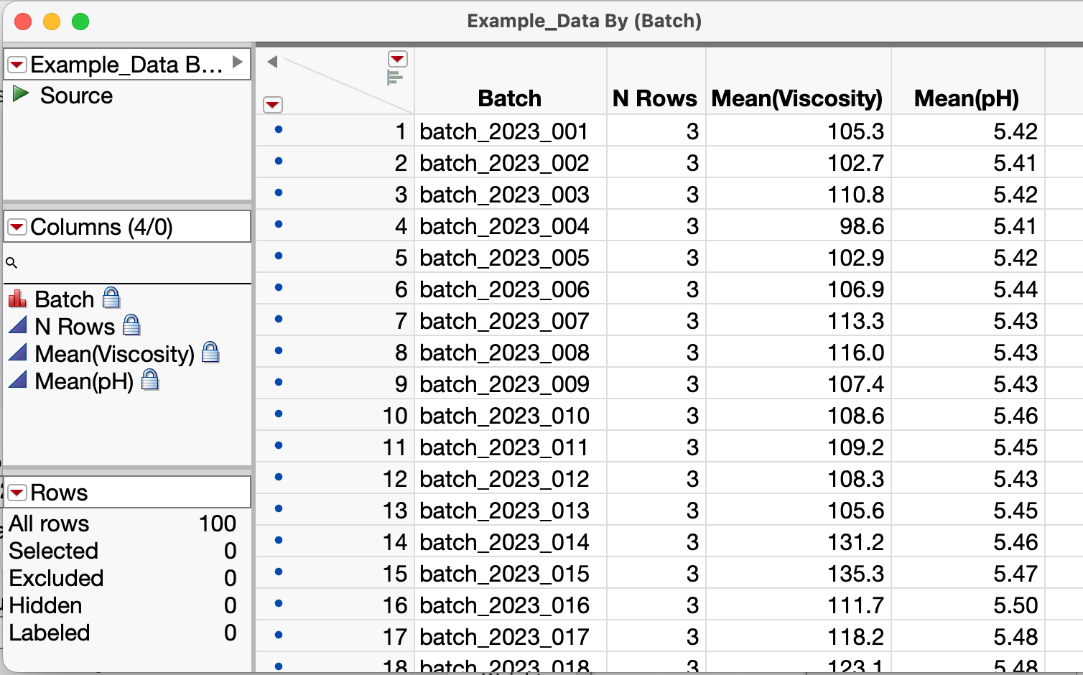
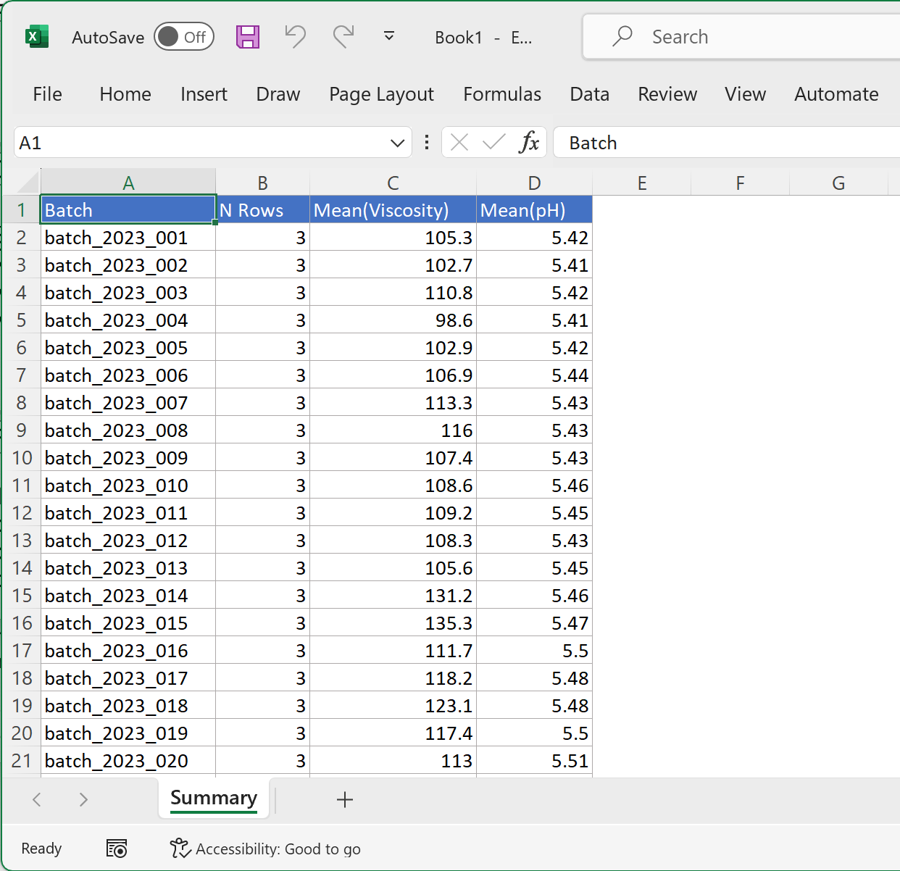
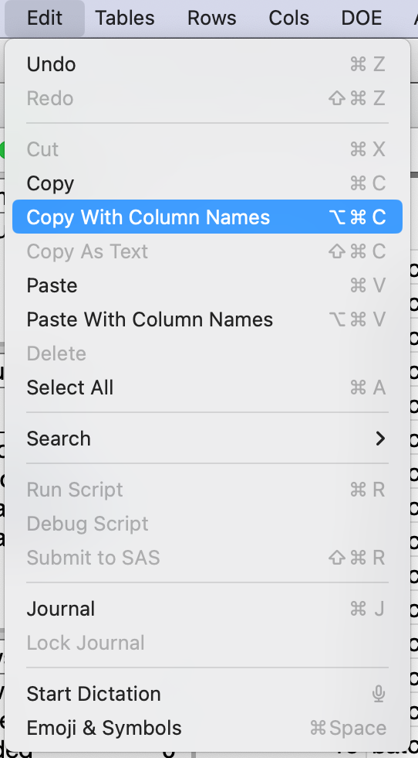
Basic Analyses (Summarize By)
JMP Summary by Batch
Summary generates a JMP data table (Optionally linked to original data)
Use Column Info to customize number formats etc.
Use Edit menu/Copy with Column Names (or Save As) to transfer across applications

Slide 14
Data selection, Column info and Data Types
Basic data selection (manual clicking)
Column Info to exclude, hide, color etc.
Column Info Menu Item - access variable Properties
Switch a variable’s data type
Other useful variable properties
Other data selection techniques

Slide 15
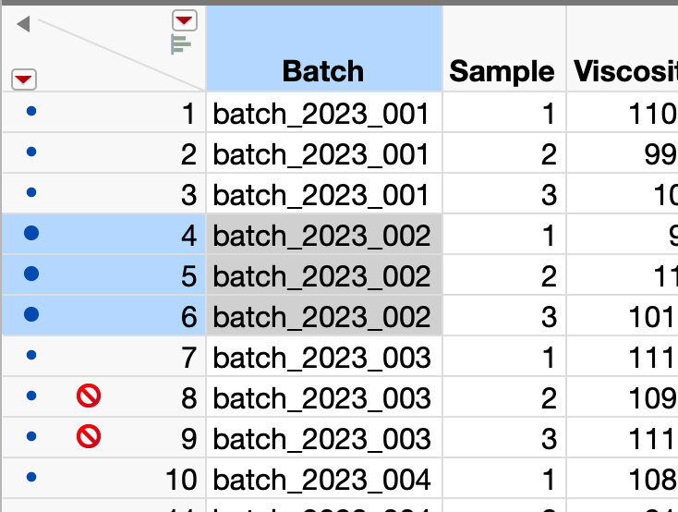
Selecting Data
Click here to clear row and column selections
Click (or shift-Click) to select Column(s)
Can independently select rows and columns
Row State shows how rows are treated on plots and analyses
As an exercise
Copy/paste the three highlighted cells into another application such as a word processor
Select Rows 8 and 9 and use Rows menu to unexclude them
Click (or shift-Click) to select Row(s)
Excluded rows
Row State info: Color for graphing, Selected status, Excluded status etc.

Slide 16
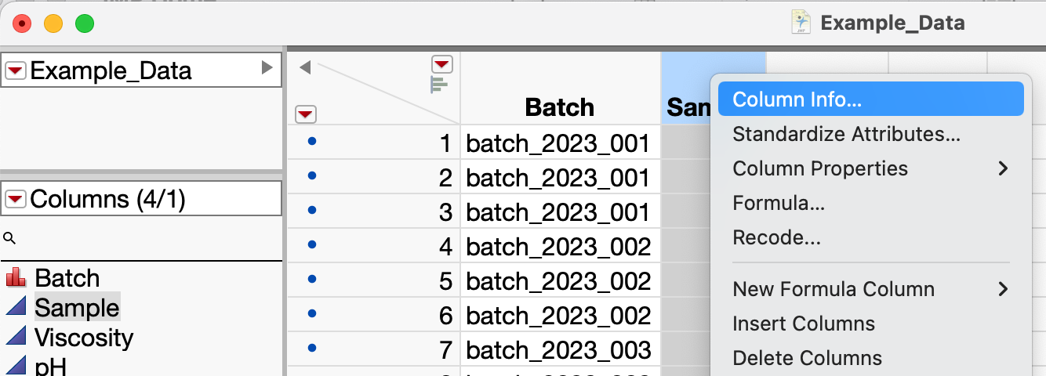
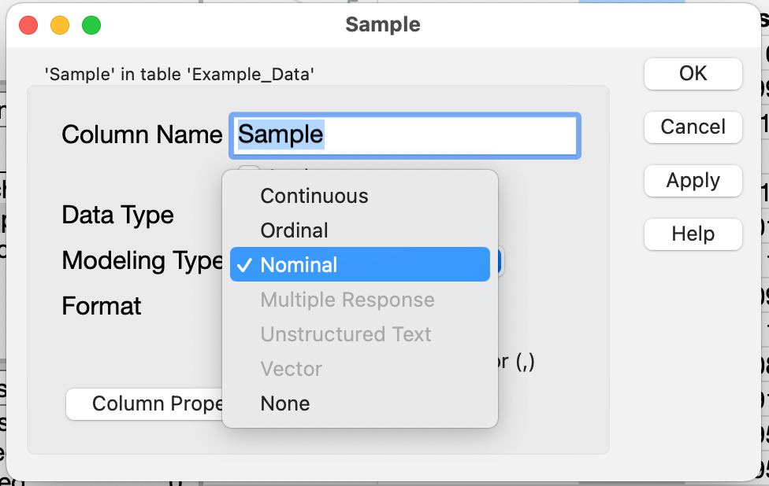
Properties of Variables (Example: Data Type)
Right/Control-Click and choose Column Info
JMP defaults numeric data to be Continuous data type (blue triangle icon)
Sample should be treated as Nominal –it’s a categorical not a numeric
Right-click on Sample column heading and choose Column Info
Select “Nominal” to treat Sample as categorical instead of numeric

Slide 17
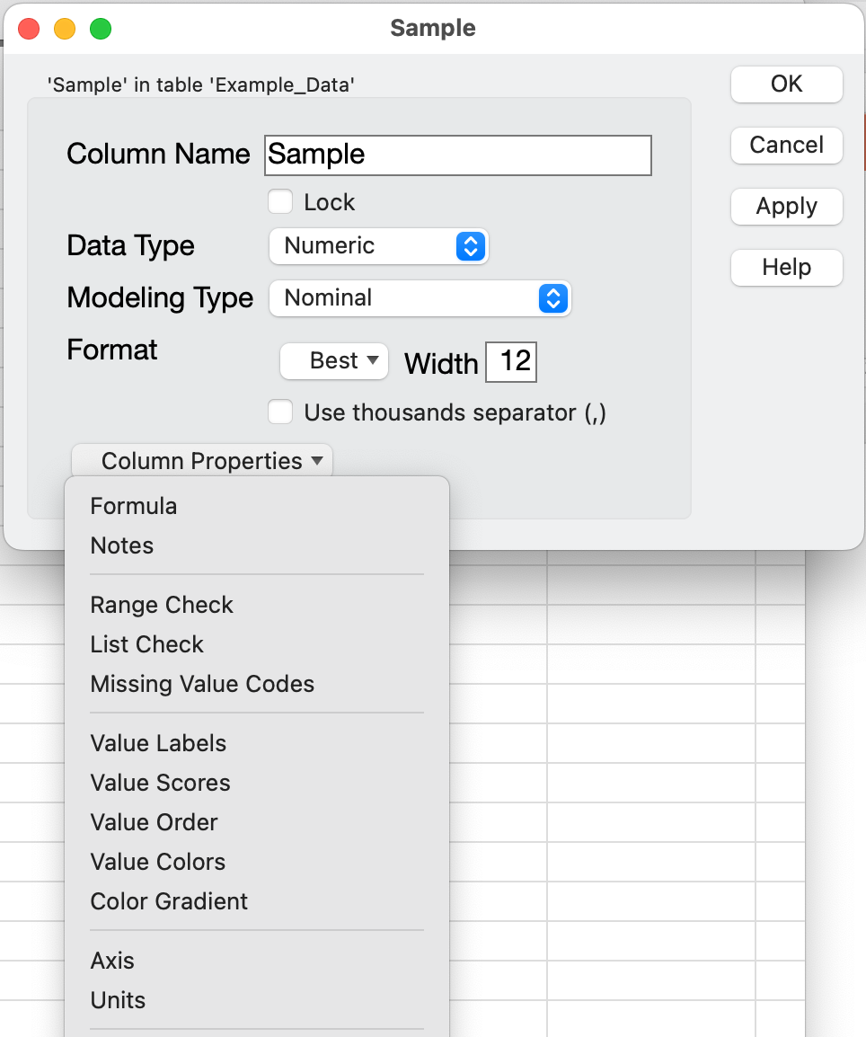
Properties of Variables
In Column Info, Column Properties is comprehensive metadata about a variable
Formula property lets you create calculated variables
Notes and Units properties curate variable’s description
Value Order controls categorical order on plots (Example: you want plot order to be “Begin, Middle, End” instead of alphabetical)

Slide 18
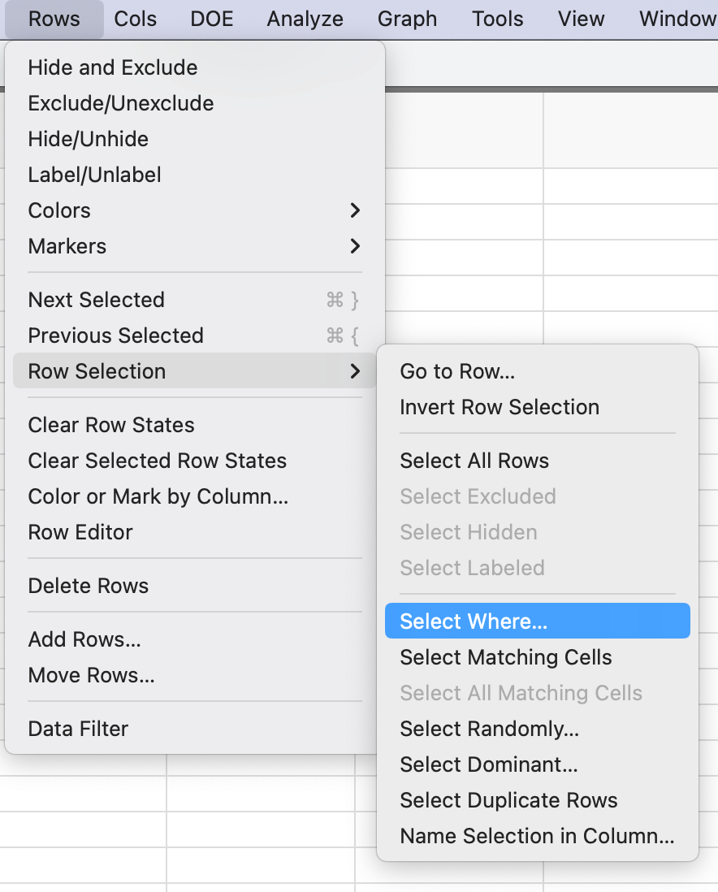
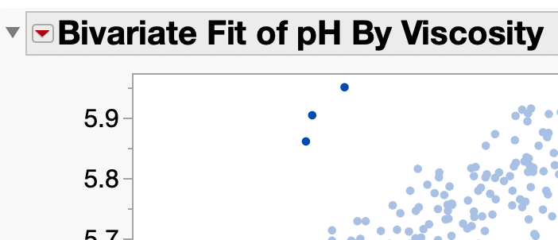
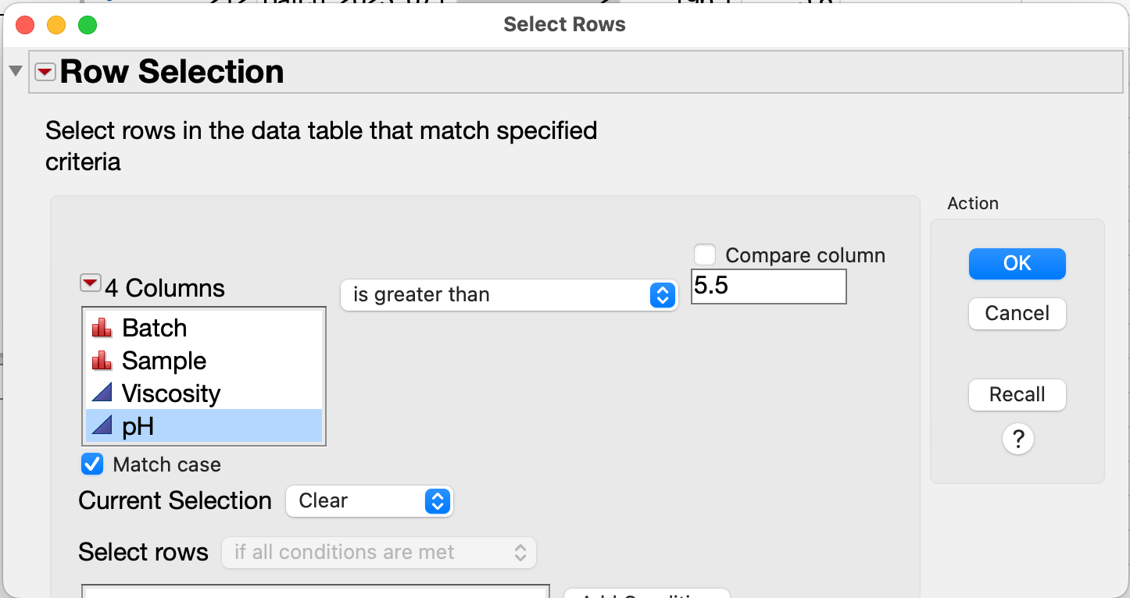
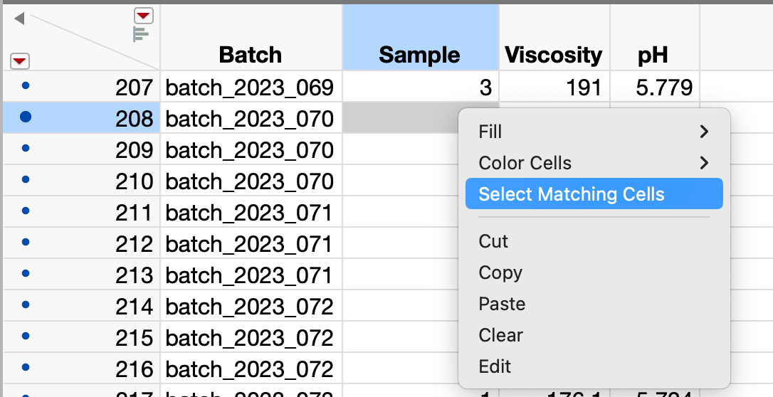
Other Data Selection Techniques
Click on points or use lasso tool to select data rows manually
Use Select Where to set criteria
Data can be selected visually on graphs using the Lasso tool or by clicking on points
Rows / Row Selection menu
Select Where criteria-based selection
Invert Row Selection helpful for working with Excluded/Hidden Row State
Control/Right-Click Select Matching Cells in data table
Right/Control-click on cell(s) to select all matching rows
[Example: select all Sample=1 rows]

Slide 19
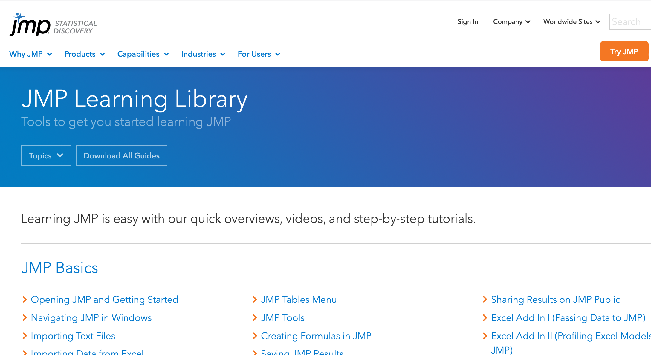
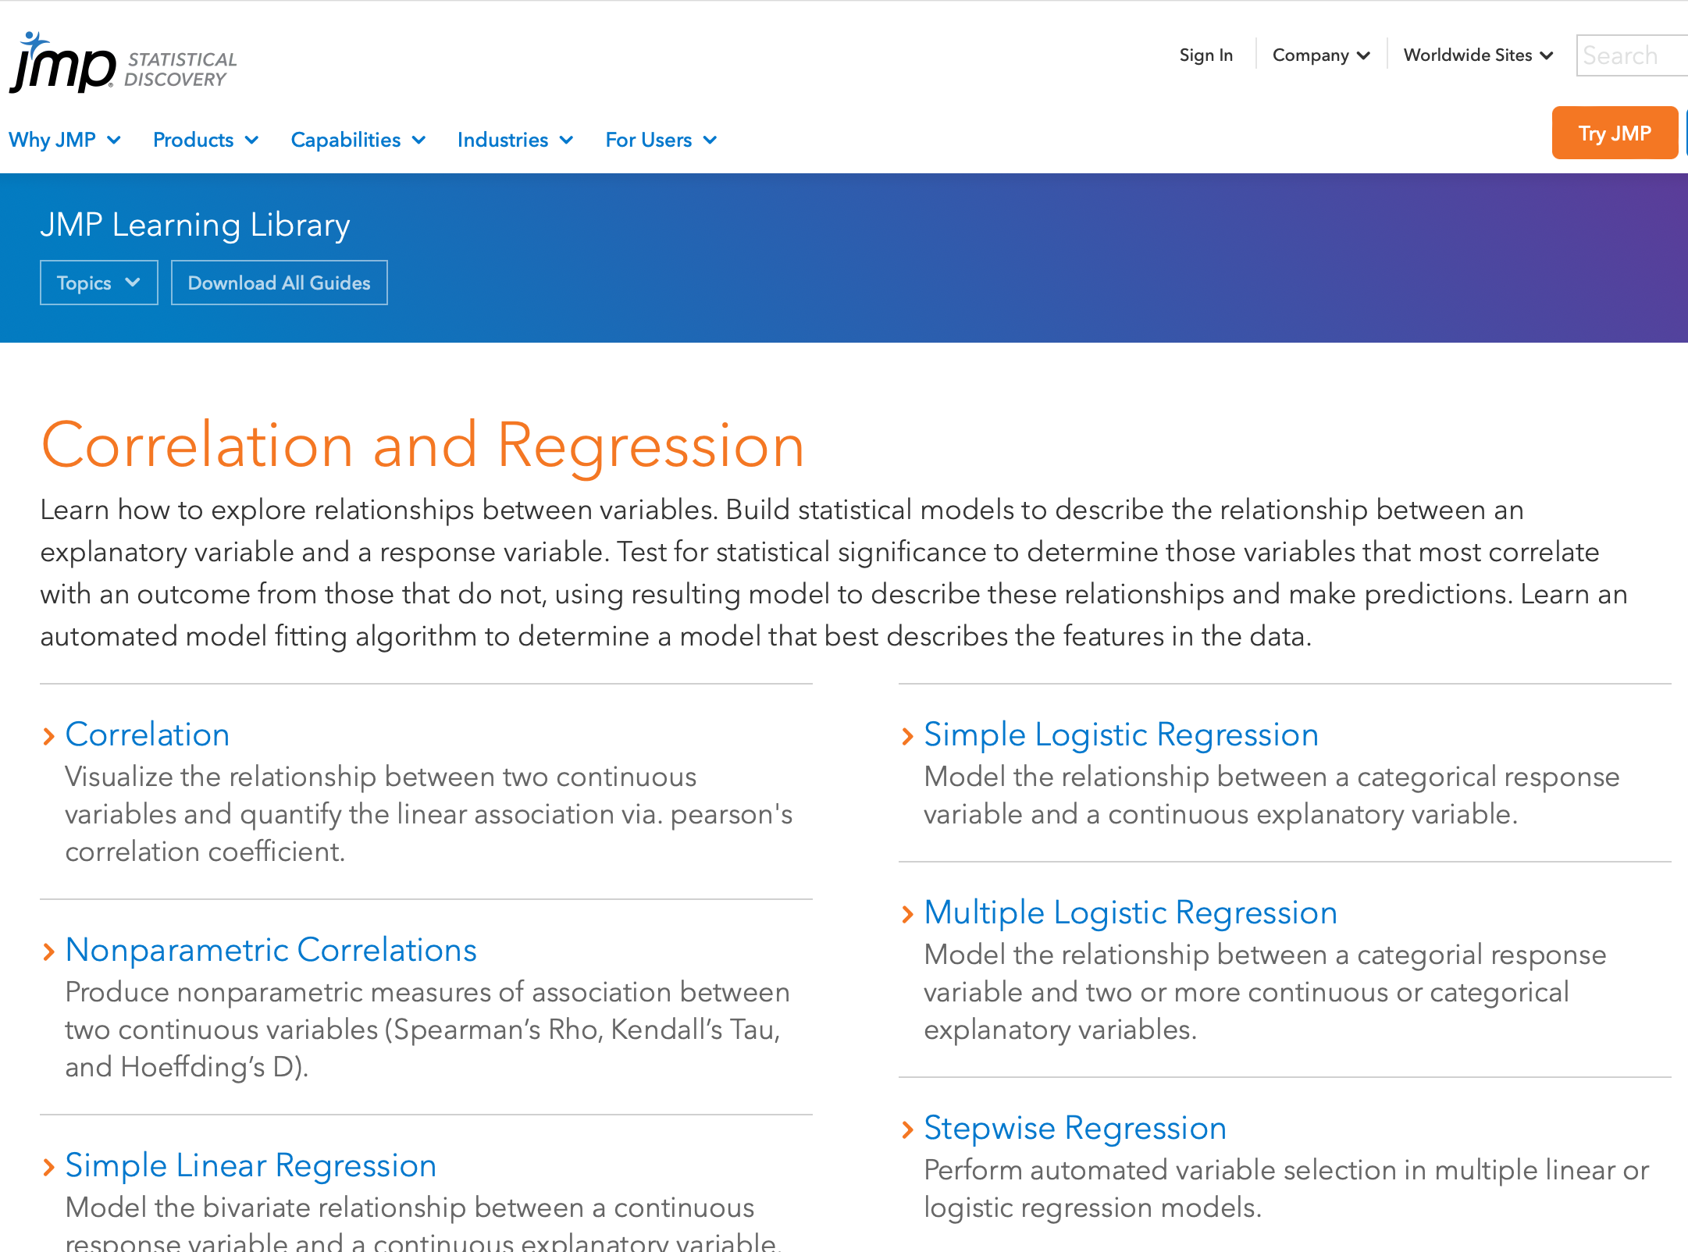
JMP Online Tutorials As Needed for additional Topics
See jmp.com/learn for additional high-quality tutorials on topics from basic to advanced
Tutorials are in PDF and video formats and use sample data from JMP’s Help menu

